Slide 1
Test Adequacy and Structural Testing
CSE 4495 - Lecture 8 - 30/08/2022
Instructor : Md. Mohaiminul Islam

Slide 2
Every developer must answer: Are our tests are any good?
More importantly… Are they good enough to stop writing new tests?

Slide 3
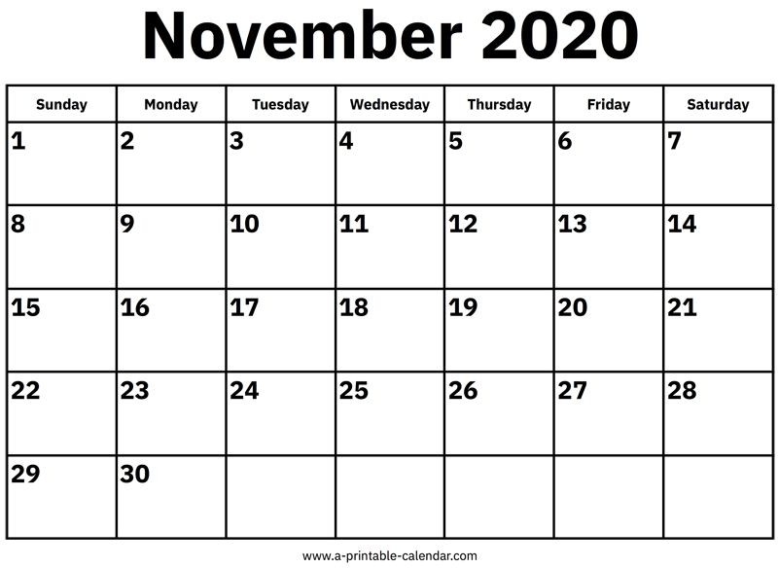


Have We Done a Good Job?
What we want:
We’ve found all the faults.
Impossible.
What we (usually) get:
We compiled and it worked.
We run out of time or budget.
Inadequate.

Slide 4

Test Adequacy Criteria
Instead - can we compromise between the impossible and the inadequate?
Can we measure “good testing”?
Test adequacy criteria “score” testing efforts by measuring the completion of test obligations.
Checklists of properties that must be met by test cases.

Slide 5
(In)Adequacy Criteria
Criteria identify inadequacies in the tests.
If no test reaches a statement, test suite is inadequate for finding faults in that statement.
If we plant a fake fault and no test exposes it, our tests are inadequate at detecting that fault.
Tests may still miss faults, but maximizing criteria shows that tests at least meet certain goals.

Slide 6
Adequacy Criteria
Adequacy Criteria based on coverage of factors correlated to finding faults (hopefully).
Exercising elements of source code (structural testing).
Detection of planted faults (fault-based testing)
Widely used in industry - easy to understand, cheap to calculate, offer a checklist.
Enable tracking of “testing completion”
Can be measured in IntelliJ, Eclipse, etc.

Slide 7
Structural Testing

Slide 8


Structural Testing
The structure of the software itself is a valuable source of information.
Prescribe how code elements should be executed, and measure coverage of those elements.
If-statements, Boolean expressions, loops, switches, paths between statements...

Slide 9
Control and Data Flow
We need to understand how system executes.
Conditional statements result in branches in execution, jumping between blocks of code.
Control flow: how control passes through code.
Which code is executed, and when.
Data flow: how data passes through code.
How variables are used in different expressions.

Slide 10
Control-Flow Graphs
Directed graph representing flow of control.
Nodes represent blocks of sequential statements.
Edges connect nodes in the sequence they are executed.
i=0
i<N
True
False
A[i]<0
False
True
Multiple edges indicate conditional statements.
A[i] = - A[i];
return(1)
i++

Slide 11

Control Flow: If-then-else
1==x
T
F
y=45;
y=23456;
/* continue */

Slide 12
Loop
1<x
T
F
/* continue */
x--;

Slide 13





Case
test
case 1...
case 2...
case 3...
/* continue */

Slide 14
Basic Blocks
Nodes are basic blocks.
Set of sequential instructions with single entry and exit point.
int i = 0;
Typically adjacent statements, but one statement might be broken up to model control flow in the statement.
i < 10 T
F
sum += i; i++;

Slide 15
Control Flow Graph Example
1 - 3
int cldx = 0;
cldx < argStr.length();
F
T
13
6
7
F
T
8-9
cldx++;

Slide 16
Structural Coverage Criteria
Criteria based on exercising:
Statements (nodes of CFG)
Branches (edges of CFG)
Conditions
Paths
… and many more
Measurements used as adequacy criteria

Slide 17
Statement Coverage
Most intuitive criteria. Did we execute every statement at least once?
Cover each node of the CFG.
The idea: a fault in a statement cannot be revealed unless we execute the statement.
Coverage = Number of Statements Covered
Number of Total Statements

Slide 18


Statement Coverage
i=0
i<N and A[i] <X
True
False
A[i]<0
False
True
A[i] = - A[i];
return A
i++
Can cover in one test: [-1], 1, 10

Slide 19
A Note on Test Suite Size
Coverage not correlated to test suite size.
Coverage depends on whether obligations are met.
Some tests might not cover new code.
However, larger suites often find more faults.
They exercise the code more thoroughly.
How code is executed often more important than
whether it was executed.

Slide 20
Test Suite Size
Favor large number of targeted tests over small number of tests that cover many statements.
If a test targets a small number of obligations, it is easier to tell where a fault is.
If a test covers a large number of obligations, we get higher coverage, but at the cost of being able to identify and fix faults.
The exception - cost to execute each test is high.

Slide 21
Branch Coverage
Do we have tests that take all of the control branches at some point?
Cover each edge of the CFG.
Helps identify faults in decision statements.
Coverage = Number of Branches Covered
Number of Total Branches

Slide 22
Subsumption
Criterion A subsumes another Criterion B if, for every program P, every test suite satisfying A also satisfies B on P.
If we satisfy A, there is no point in measuring B.
Branch coverage subsumes statement coverage.
Covering all edges in CFG requires covering all nodes in a graph.

Slide 23
Subsumption
Shouldn’t we always choose the stronger metric?
Not always…
Typically require more obligations.
(so, you have to come up with more tests)
Or, at least, tougher obligations.
(making it harder to come up with the test cases).
May end up with a large number of unsatisfiable obligations.

Slide 24
Branch Coverage
i=0
i<N and A[i] <X
True
False
A[i]<0
False
True
A[i] = - A[i];
return A
i++
([-1], 1, 10) leaves one edge uncovered.
([-1, 1], 2, 10) achieves Branch Coverage.

Slide 25
Let’s take a break.

Slide 26
Decisions and Conditions
A decision is a complex Boolean expression.
Often cause control-flow branching:
if ((a && b) || !c) { ...
But not always:
Boolean x = ((a && b) || !c);

Slide 27
Decisions and Conditions
A decision is a complex Boolean expression.
Made up of conditions
Connected with Boolean operators (and, or, xor, not):
Boolean variables: Boolean b = false;
Subexpressions that evaluate to true/false involving (<, >, <=, >=,
==, and !=): Boolean x = (y < 12);

Slide 28
Decision Coverage
Branch Coverage deals with a subset of decisions.
Branching decisions that decide how control is routed through the program.
Decision coverage requires that all boolean decisions evaluate to true and false.
Coverage = Number of Decisions Covered
Number of Total Decisions

Slide 29
Basic Condition Coverage
Several coverage metrics examine the individual
conditions that make up a decision.
Identify faults in decision statements.
(a == 1 || b == -1) instead of (a == -1 || b == -1)
Most basic form: make each condition T/F.
Coverage = Number of Truth Values for All Conditions
2x Number of Conditions

Slide 30
Basic Condition Coverage
Make each condition both True and False
(A and B)
Does not require hitting both branches.
Does not subsume branch coverage.
In this case, false branch is taken for both tests
Test Case | A | B
1 | True | False
2 | False | True

Slide 31
Basic Condition Coverage
i=0
i<N and A[i] <X
True
False
A[i]<0
False
True
A[i] = - A[i];
return A
i++
([-1, 1], 2, 10)
Negative value in array
Positive value (but < X)
([11], 1, 10)
Positive, but > X
Both eventually cause i < N to be false.

Slide 32
Compound Condition Coverage
Evaluate every combination of the conditions
(A and B)
Subsumes branch coverage.
All outcomes are now tried.
Can be expensive in practice.
Test Case | A | B
1 | True | True
2 | True | False
3 | False | True
4 | False | False

Slide 33
Compound Condition Coverage
Requires many test cases.
(A and (B and (C and D))))
Test Case | A | B | C | D
1 | True | True | True | True
2 | True | True | True | False
3 | True | True | False | True
4 | True | True | False | False
5 | True | False | True | True
6 | True | False | True | False
7 | True | False | False | True
8 | True | False | False | False
9 | False | True | True | True
10 | False | True | True | False
11 | False | True | False | True
12 | False | True | False | False
13 | False | False | True | True
14 | False | False | True | False
15 | False | False | False | True
16 | False | False | False | False

Slide 34
Short-Circuit Evaluation
In many languages, if the first condition determines the result of the entire decision, then fewer tests are required.
If A is false, B is never evaluated.
(A and B)
Test Case | A | B
1 | True | True
2 | True | False
3 | False | -

Slide 35
Modified Condition/Decision Coverage(MC/DC)
Requires:
Each condition evaluates to true/false
Each decision evaluates to true/false
Each condition shown to independently affect outcome
of each decision it appears in.
Test Case | A | B | (A and B)
1 | True | True | True
2 | True | False | False
3 | False | True | False
4 | False | False | False

Slide 36
Modified Condition/Decision Coverage(MC/DC)
Requires:
Each condition evaluates to true/false
Each decision evaluates to true/false
Each condition shown to independently affect outcome
of each decision it appears in.
Test Case | A | B | (A and B)
1 | True | True | True
2 | True | False | False
3 | False | True | False
4 | False | False | False

Slide 37


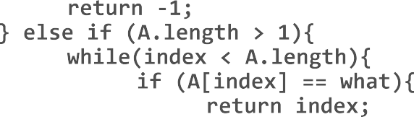

Activity
Draw the CFG and write tests that provide statement, branch, and basic condition coverage over the following code:

Slide 38
Activity - Control Flow Graph
index=0
False
False
False
(A.length ==1) && (A[0] = what)
A.length
==0
A.length
>1
return -1;
True
False
True
index < A.length
True
return 0;
return -1;
True
A[index]
== what
False
index++;
True
return index;

Slide 39

Activity - Possible Solution
index=0
(N==1) &&
(A[0] = what)
False
False
False
N==0
N>1
return -1;
True False
index
< N
True
True
return 0;
return -1;
True
A[index]
== what
False
index++;
1: A[“Bob”, “Jane”], 2, “Jane”
2: A[“Bob”, “Jane”], 2, “Spot”
3: A[], 0, “Bob”
4. A[“Bob”], 1, “Bob”
5. A[“Bob”], 1, “Spot”
return index;
True

Slide 40
Activity - Possible Solution
index=0
(N==1) &&
(A[0] = what)
False
False
False
N==0
N>1
return -1;
True False
index
< N
True
True
return 0;
return -1;
True
A[index]
== what
False
index++;
1: A[“Bob”, “Jane”], 2, “Jane”
2: A[“Bob”, “Jane”], 2, “Spot”
3: A[], 0, “Bob”
4. A[“Bob”], 1, “Bob”
5. A[“Bob”], 1, “Spot”
return index;
True

Slide 41
Activity - Possible Solution
index=0
(N==1) &&
(A[0] = what)
False
False
False
N==0
N>1
return -1;
True False
index
< N
True
True
return 0;
return -1;
True
A[index]
== what
False
index++;
1: A[“Bob”, “Jane”], 2, “Jane”
2: A[“Bob”, “Jane”], 2, “Spot”
3: A[], 0, “Bob”
4. A[“Bob”], 1, “Bob”
5. A[“Bob”], 1, “Spot”
return index;
True

Slide 42
Loop Boundary Coverage
Focus on problems related to loops.
Cover scenarios representative of how loops might be executed.
For each loop, write tests that:
Skip the loop entirely.
Take exactly one pass through the loop.
Take two or more passes through the loop.

Slide 43
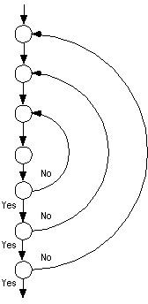
Nested Loops
Often, loops are nested within other loops.
For each level, execute 0, 1, 2+ times
In addition:
Test innermost loop first with outer loops executed minimum number of times.
Move one loops out, keep the inner loop at “typical” iteration numbers, and test this layer as you did the previous layer.
Continue until the outermost loop tested.

Slide 44
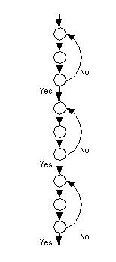
Concatenated Loops
One loop executes. Next line of code starts a new loop. These are generally independent.
If not, follow a similar strategy to nested loops.
Start with bottom loop, hold higher loops at minimal iteration numbers.
Work up towards the top, holding lower loops at “typical” iteration numbers.

Slide 45
Why These Loop Strategies?
If proving correctness, we establish preconditions, postconditions, and invariants that are true on each execution of loop.
The loop executes zero times when the postconditions are true in advance.
The loop invariant is true on loop entry (one), then each loop iteration maintains the invariant (many).
(invariant and !(loop condition) implies postconditions are met)
Loop testing strategies echo these cases.

Slide 46
The Infeasibility Problem
Sometimes, no test can satisfy an obligation.
Impossible combinations of conditions.
Unreachable statements as part of defensive programming.
Error-handling code for conditions that can’t occur.
Dead code in legacy applications.

Slide 47
The Infeasibility Problem
Stronger criteria call for potentially infeasible combinations of elements.
(a > 0 && a < 10)
It is not possible for both conditions to be false.
A is negative and greater than 10
Loop boundary coverage - loop can’t be skipped.

Slide 48
The Infeasibility Problem
Adequacy “scores” based on coverage.
95% branch coverage, 80% MC/DC coverage, etc.
Stop once a threshold is reached.
Unsatisfactory solution - elements are not equally important for fault-finding.
Manual justification for omitting each impossible test obligation.
Helps refine code and testing efforts.
… but very time-consuming.

Slide 49
Which Coverage Criterion Should I Use?
Loop Boundary Testing
Branch Coverage
Statement Coverage
MC/DC Coverage
Branch and Condition Coverage
Basic Condition Coverage
Power, Cost

Slide 50
Thank You

